Slide 1
The OTENTIK trust network

Slide 2
We all wish to live in a world based on trust.

Slide 3
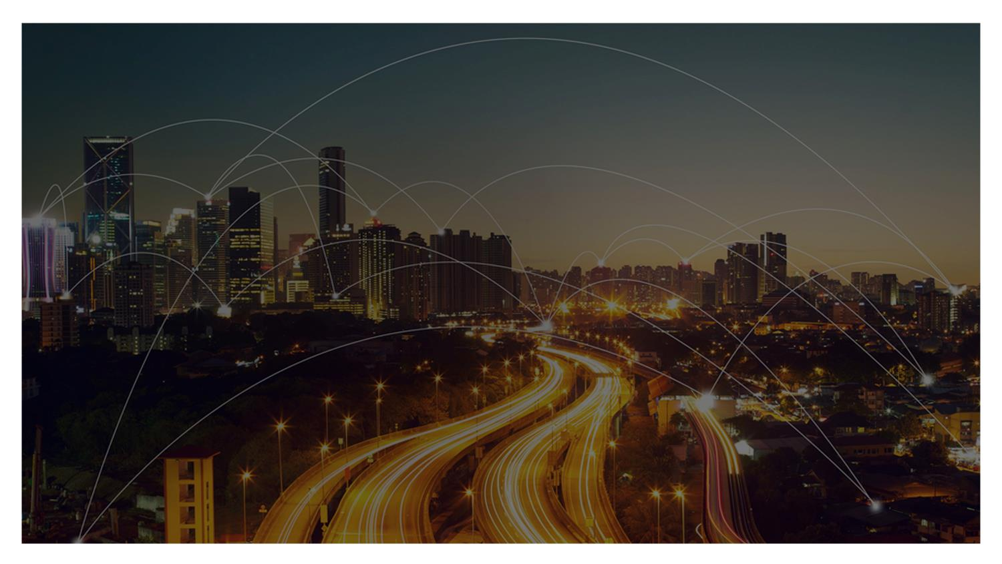
Every day,
billions of documents
and objects are created,
used and consulted.
Our social and economic fabric depends on it, sometimes vitally.

Slide 4
This trust is shaken,
daily.
New technologies and deceits reduce the barrier to entry for counterfeiting and fraud.

Slide 5
Counterfeiting is widespread in some countries.
What confidence do we give to these documents and products?

Slide 6
Imagine a TRUST network connecting those who verify to those who certify.

Slide 7
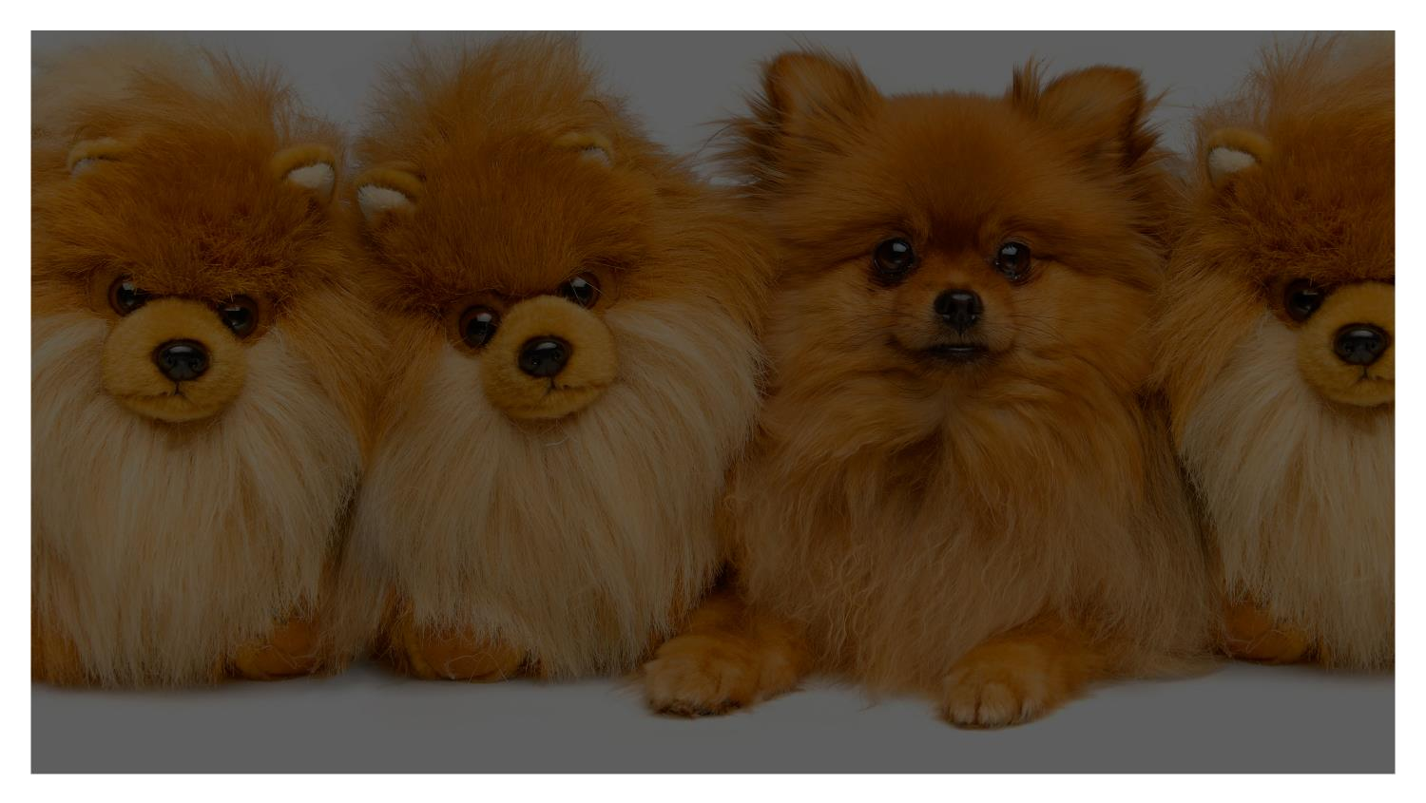
Imagine a trust network
to validate the legitimacy of the
documents we consult and the goods or objects around us.

Slide 8
We imagined it.
its foundation adheres to the principles of eIDAS and GDPR.
It will be fully operational in 2019.

Slide 9
The Otentik trust network connects the user* who verifies the legitimacy of the document (or the object) to the one who certified it.
* Whether citizen, public or private actor, the user can act as an inspector in the context of ISO 16678.

Slide 10
It ensures the legitimacy of the issuer, and validates the nature of the information certified.
Its operation is delegated to certification authorities (CA), acting as trusted third party.

Slide 11
At the heart of the OTENTIK trust network is the VDS - Visible digital Seal.
ORIGIN
It is a 2D barcode applied to the document or object.
Key data
It includes key data that is electronically signed to detect tampering, to confirm the authenticity of the document and the legitimacy of the issuer.
LeGITIMacy

Slide 12
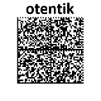
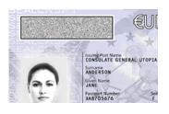
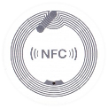
The OTENTIK VDS can use standard or proprietary 2D codes (ex.: Datamatrix, QR, or SealCrypt, Alphacode).
It can even be stored in an RFID tag.
The code used is generally defined by the use case or the amount of information.

Slide 13
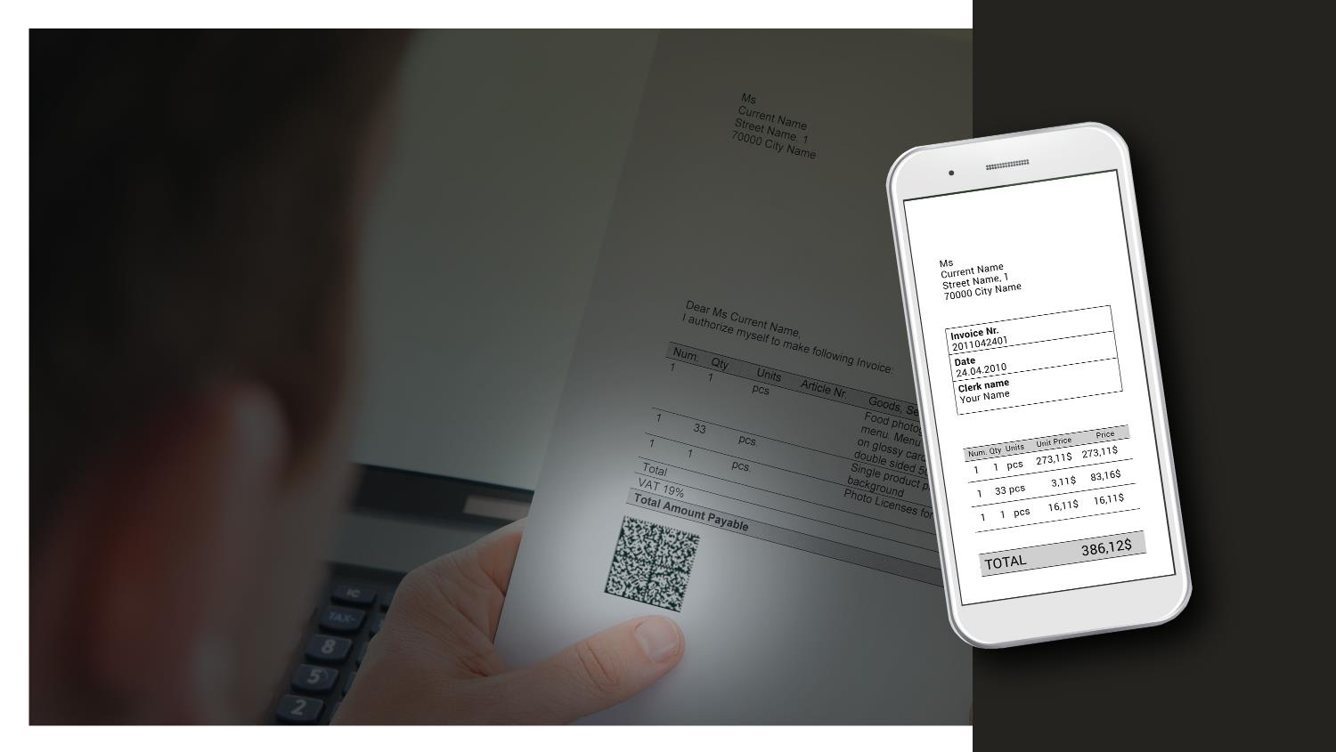
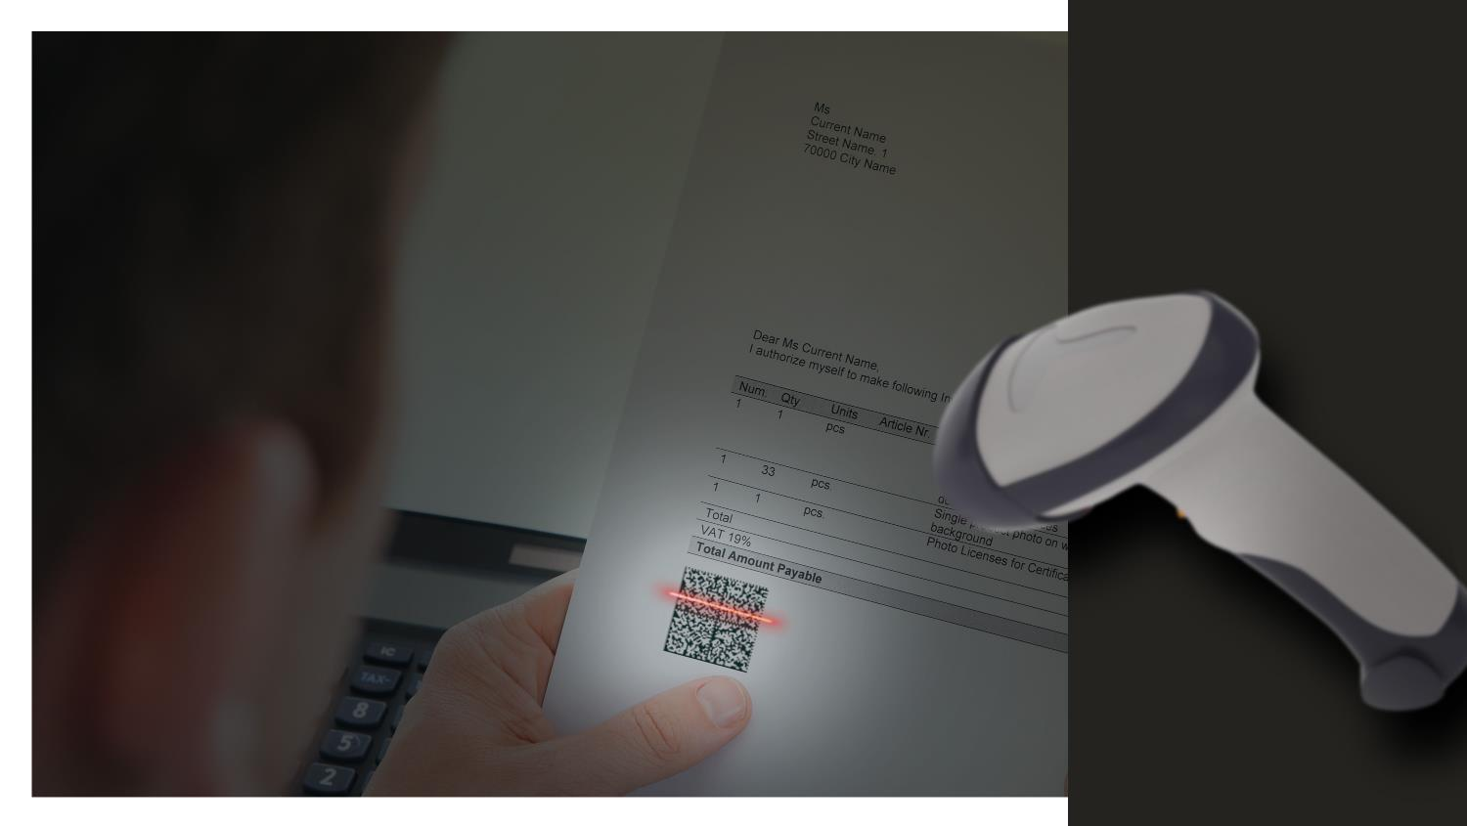
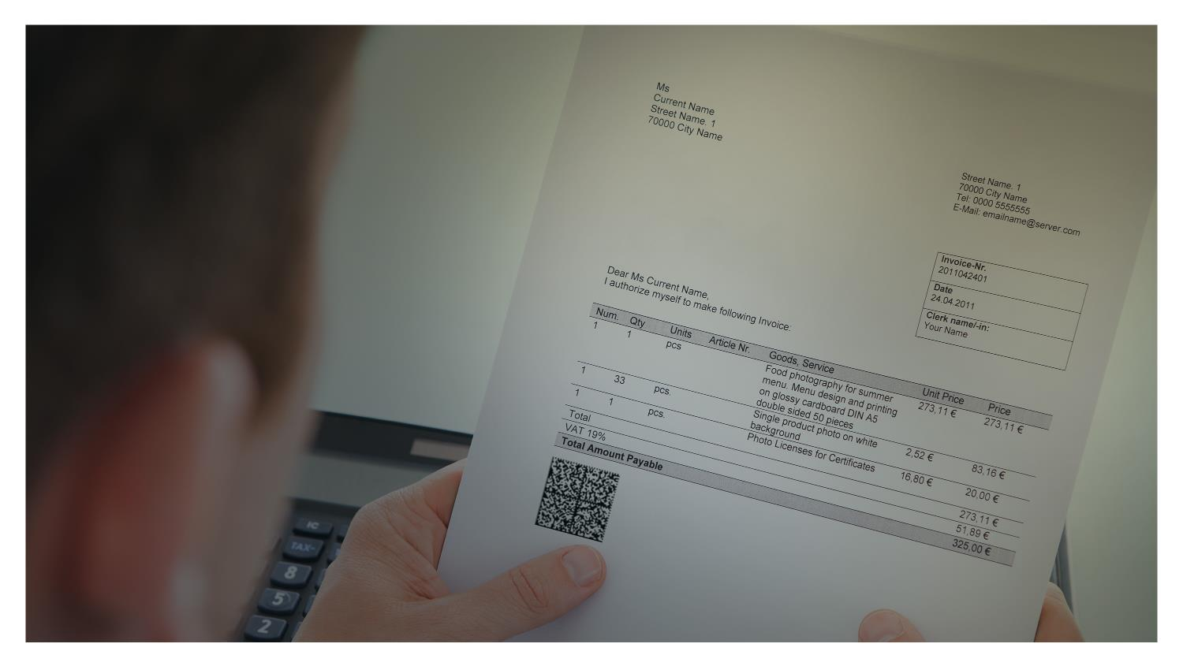
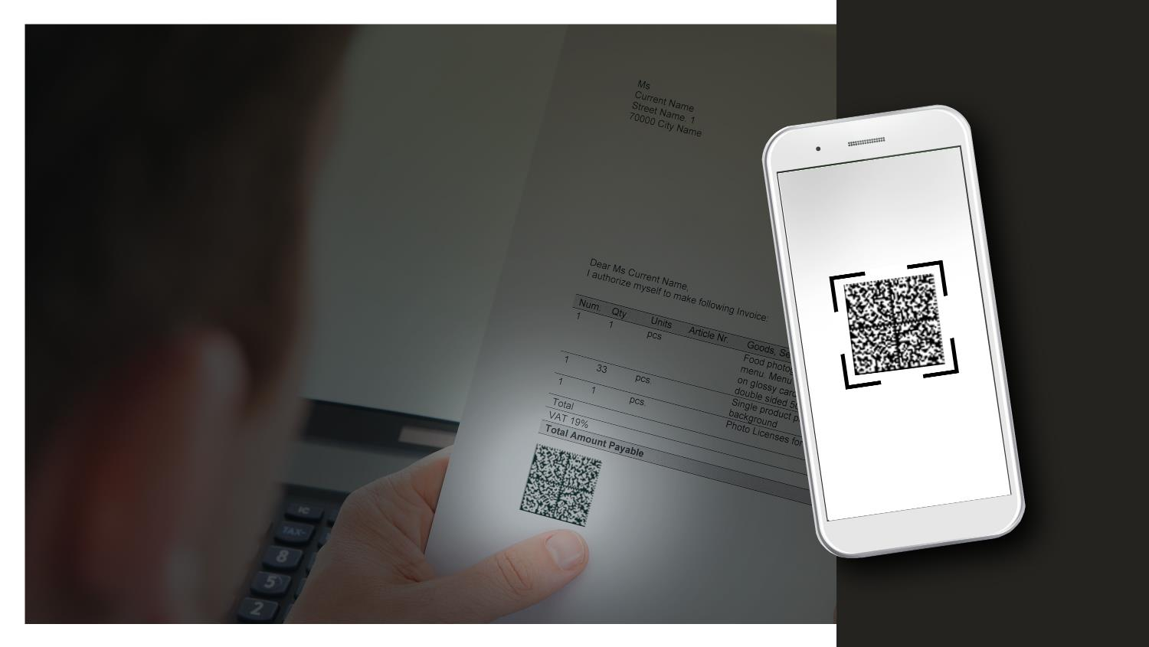
Its validation is simple and easy.

Slide 14
The Otentik VDS can be validated offline.
Online validation can offer several advanced features, such as access to the original electronic document, or real-time traceability.
It can easily integrate to various Blockchain initiatives.

Slide 15
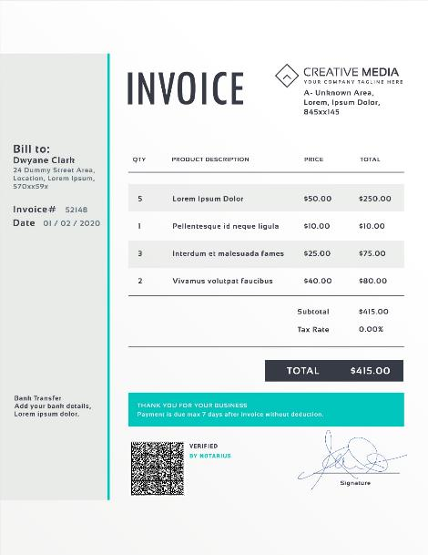
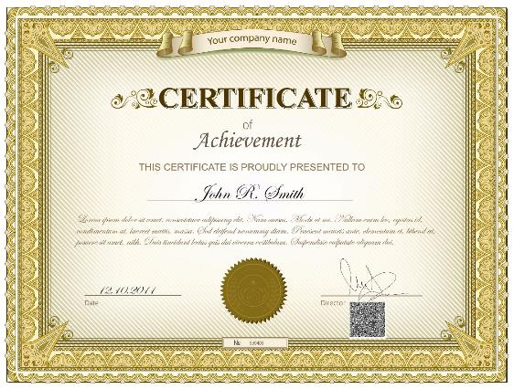
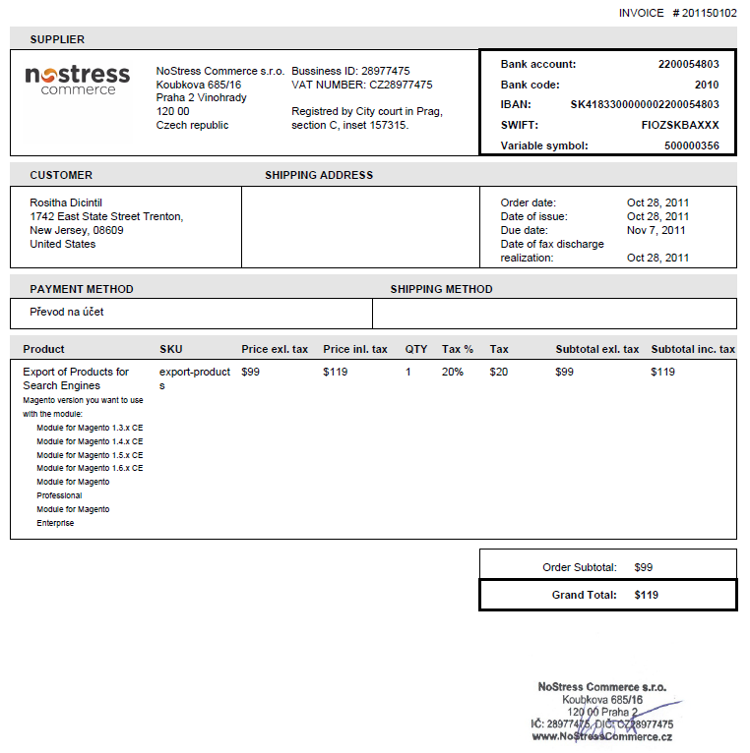
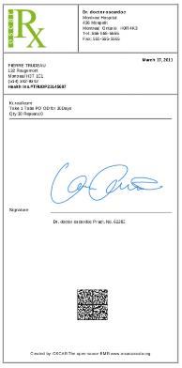
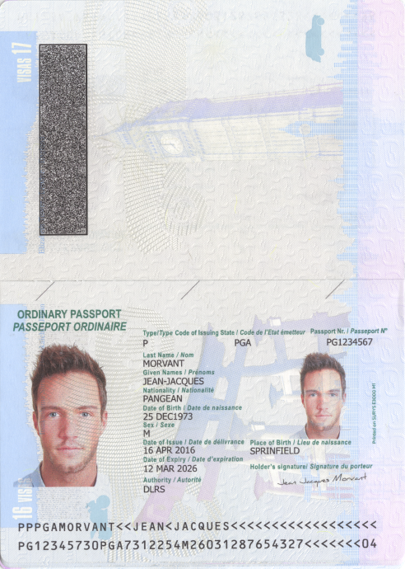
Its true limit:
our imagination

Slide 16
This VDS is leveraging the AFNOR standard XP Z42-101 (France), and is on its way to ISO.
It is the evolution of the ANTS 2D-DOC VDS technical specification, in operation since 2012.

Slide 17
The OTENTIK network federates the governance required for each type of VDS on its network (Otentik VDS, 2D-Doc VDS, etc)
Efforts to standardize internationally this governance will begin shortly.
Each VDS specification can thus evolve with great autonomy, and the network ensures the highest standards in terms of identity and legitimacy.

Slide 18
About the VDSIC
Founded in 2016 by 20 public and private entities.
It ensures the governance of the OTENTIK Trust Network, the standardization of data on the network and the adoption of the VDS.

Slide 19
Questions?
Otentik.codes
info@otentik.codes

